Slide 1
Qualitative Testing of Carbohydrates
Chemistry 102 Lab 5

Slide 2
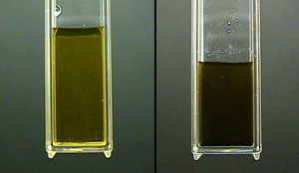
Iodine’s test
Iodine test is Specific to Starch – To differentiate between Mono- & Di-saccharides (-ve), and Starch (+ve). The structure of starch is a such that the molecule is coiled. Iodine reagent (I₂ + KI) forms I₂KI, which interact specifically with these coiled molecules to form a blue colored complex. A positive iodine assay indicates the presence of starch, so if the color turns dark blue, this is a positive result.
Procedure & observation:
- To 2 mL of carbohydrate solution in a test tube, add 1-2 drops of Iodine solution
Mix well, a deep blue colour appears.
Warm up, the colour disappears.
Cool down, the colour re-appears
a negative test (left) and a positive test (right)

Slide 3
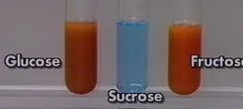
Benedict’s test
Benedict test is Specific to reducing sugars, sugars with a free aldehyde or ketone group) such as Fructose, Glucose, Galactose, Lactose & Maltose. To differentiate between non-reducing & reducing sugars. Positive test is a yellowish orange or red ppt.
CuSO₄ Cu⁺⁺ + SO₄⁻⁻ 2 Cu⁺⁺ + Reducing Sugar (electron donor) Cu⁺
Cu⁺ Cu₂O (precipitate)
Procedure & observation:
To 2 mL of carbohydrate solution in a test tube, add 1 mL of
Benedict reagent.
Mix well, and boil it up for 2 min
Observe yellowish orange or red ppt.

Slide 4
Seliwanoff’s test
Seliwanoff test is Specific to Keto sugars (Fructose or fructose-containing carbohydrates such as Sucrose). To differentiate between aldehydic and ketonic saccharides.
The Ketonic saccharides are more reactive than Aldehyde group of Aldoses and it reacts rapidly with Seliwanoff's reagent [Contains resorcinol + conc. HCl] to form furfural derivative.
Procedure & observation:
- To 2 mL of carbohydrate solution in a test tube, add 1 mL of Seliwanoff’s reagent.
Mix well, and boil it up for 1 min only.
Observe red color.

Slide 7
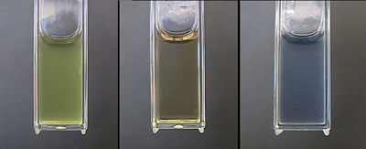
A positive test is indicated by:
The formation of a bluish product. All other colors indicate a negative result for pentoses. Note that hexoses generally react to form green, red, or brown products.
two negative tests (left, middle) and a positive test (right)

Slide 8
The 2,4 Dinitrophenylhydrazine Test
Shows positive test for: aldehydes and ketones
Reactions: reacts with the carbonyl group of aldehydes and ketones
How to perform the test: Five drops of the compound to be tested are mixed with 5 drops of the dinitrophenylhydrazine reagent (an orange solution) in 2 ml of ethanol and the tube shaken. If no positive test is observed immediately, the mixture should be allowed to stand for 15 minutes.

Slide 9
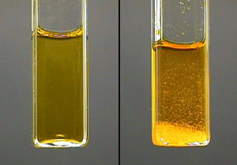
A positive test is indicated by: The formation of a yellow, orange or orange-red precipitate
a negative test (left) and a positive test (right)

